Slide 1

Exercise 4: Message GUI

Slide 2
Exercise 4: Message GUI
In this exercise you will write a GUI for the Message Board we developed in Exercise 1. What kinds of widgets will you need? How should they be laid out on the UI? Use my solution on the last page for reference.
Copy the Message Board code from Exercise 1.
Create the widgets you want. Pack them one on top of the other for now.
Add callback functions to the buttons.
Connect the callbacks to the Message Board object.
Notes:
Not too ruff
Won’t hurt my felines.
Getters and Setters (not the Irish kind)
No need to Pause between them

Slide 3
Exercise 4: Message GUI
Now focus on the layout for the Message Board GUI.
Use “pack” or “grid” geometry as desired
Use frames to organize widgets as needed
Optional: Move the “clear” functionality to a menu item
Notes:
Not too ruff
Won’t hurt my felines.
Getters and Setters (not the Irish kind)
No need to Pause between them

Slide 4
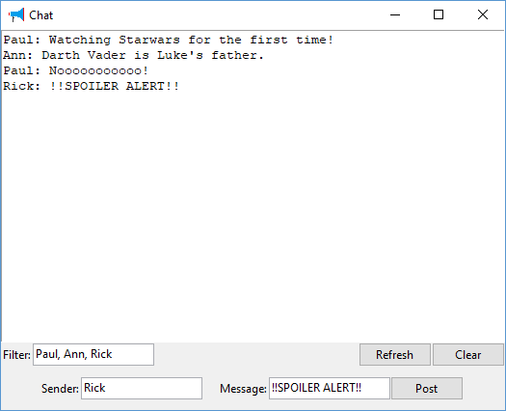
Exercise 4: Message GUI
Message Board
Notes:
Not too ruff
Won’t hurt my felines.
Getters and Setters (not the Irish kind)
No need to Pause between them

